Slide 1
Round peg in a square hole; making Southern Ocean maps
🐟

Slide 2
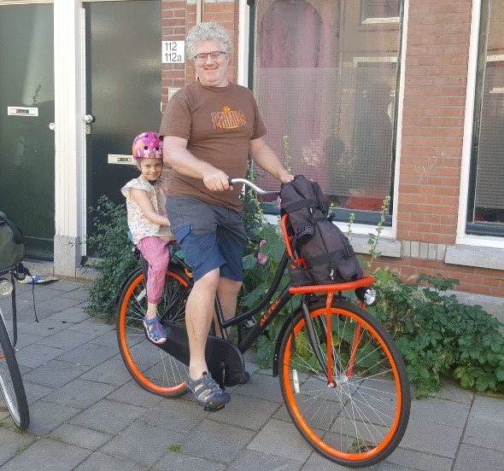

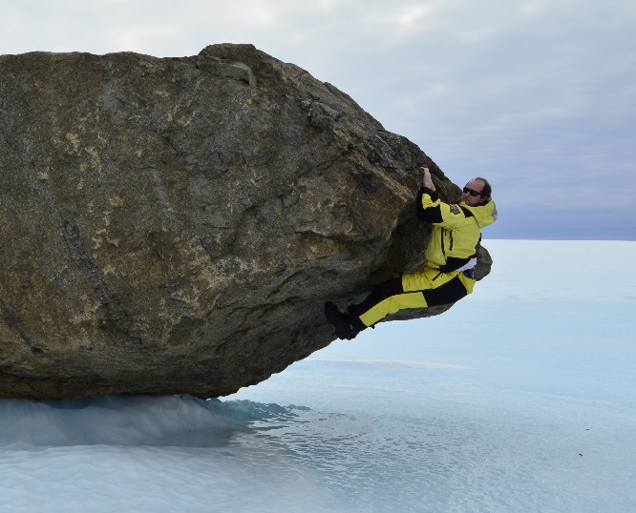


Hello!
Dale Maschette
Fisheries Research Assistant,
Australian Antarctic Division
@Dale_Masch
Maschette
Michael Sumner
Software and Database Engineer,
Australian Antarctic Division
@mdsumner
mdsumner
🐟
Notes:
Mike is in Europe.

Slide 3
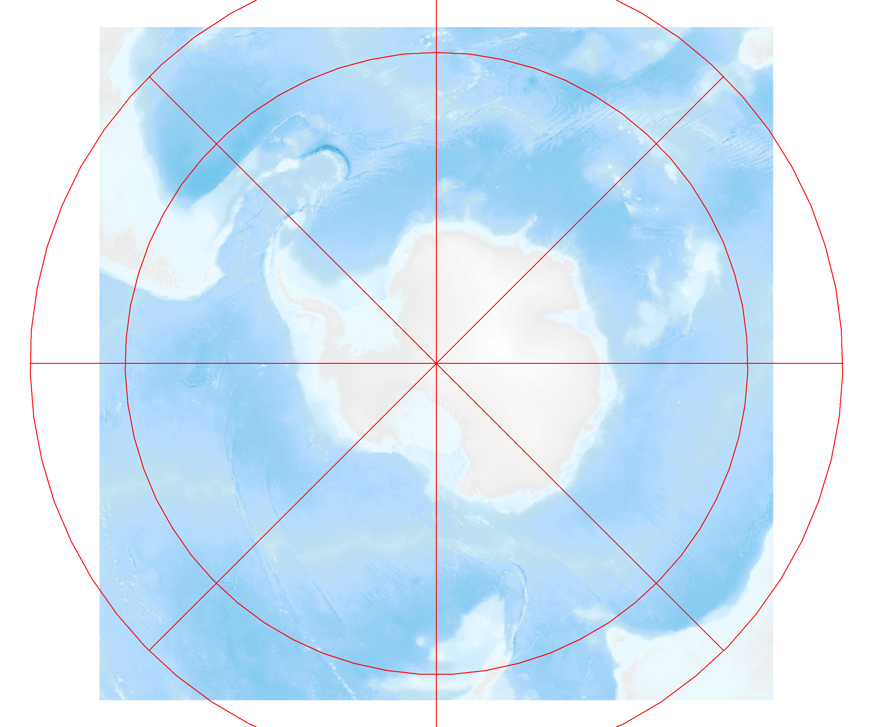
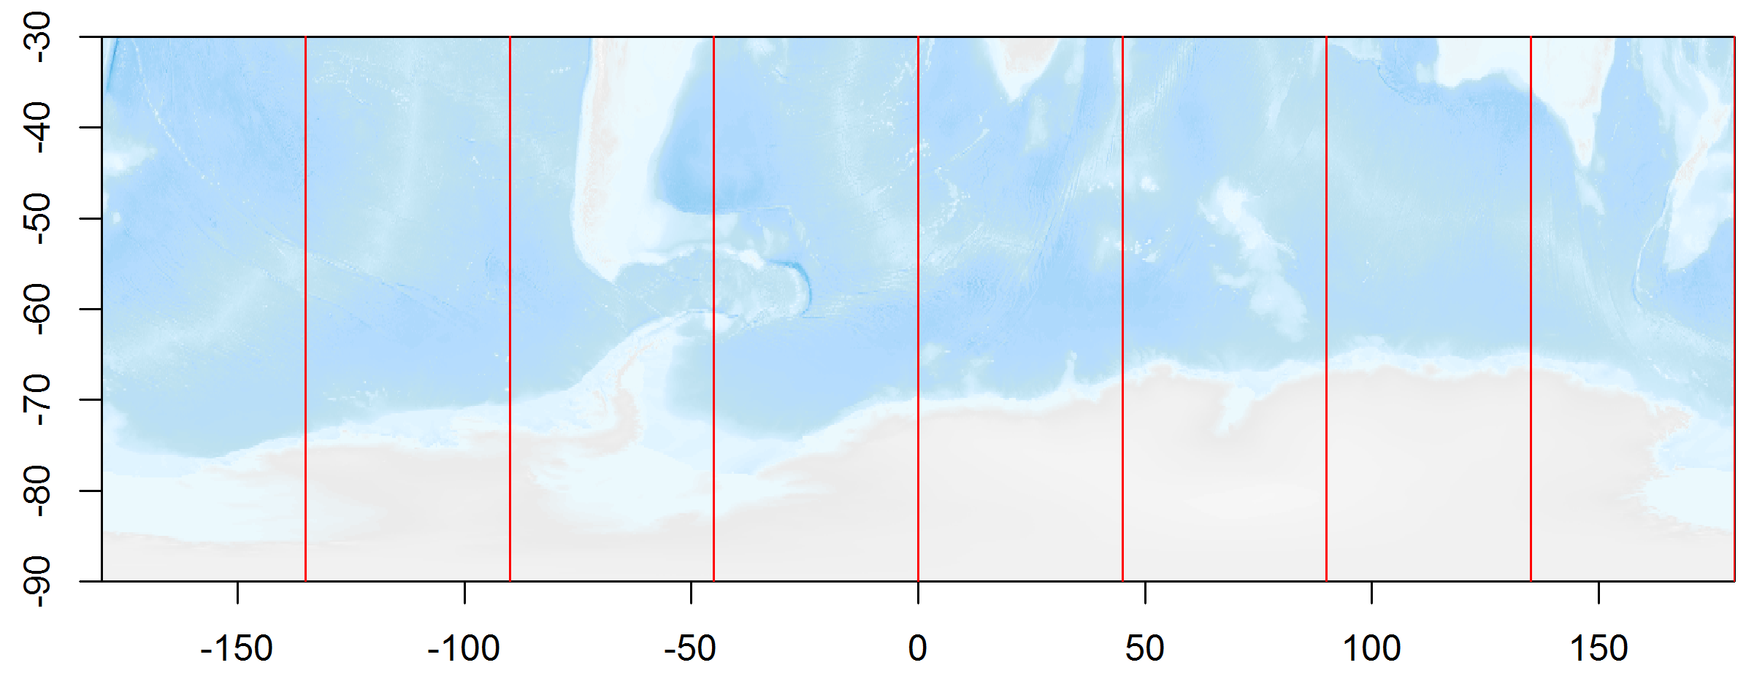
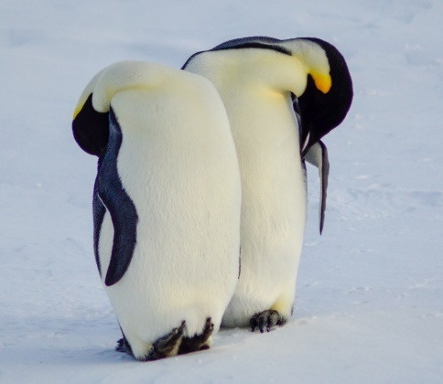
Making Polar maps sucks.
🐟
Y
Y
X
X
Notes:
To make a publication quality polar map averages 100-150 lines of code. Normal projections are like a plot, x along the bottom y going up. A polar projection is y in every direction and x in circles. You end up with corners which are useless.

Slide 4
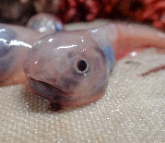
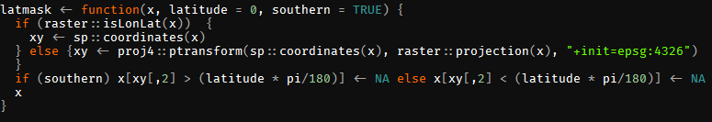
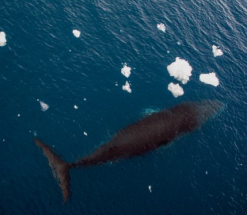
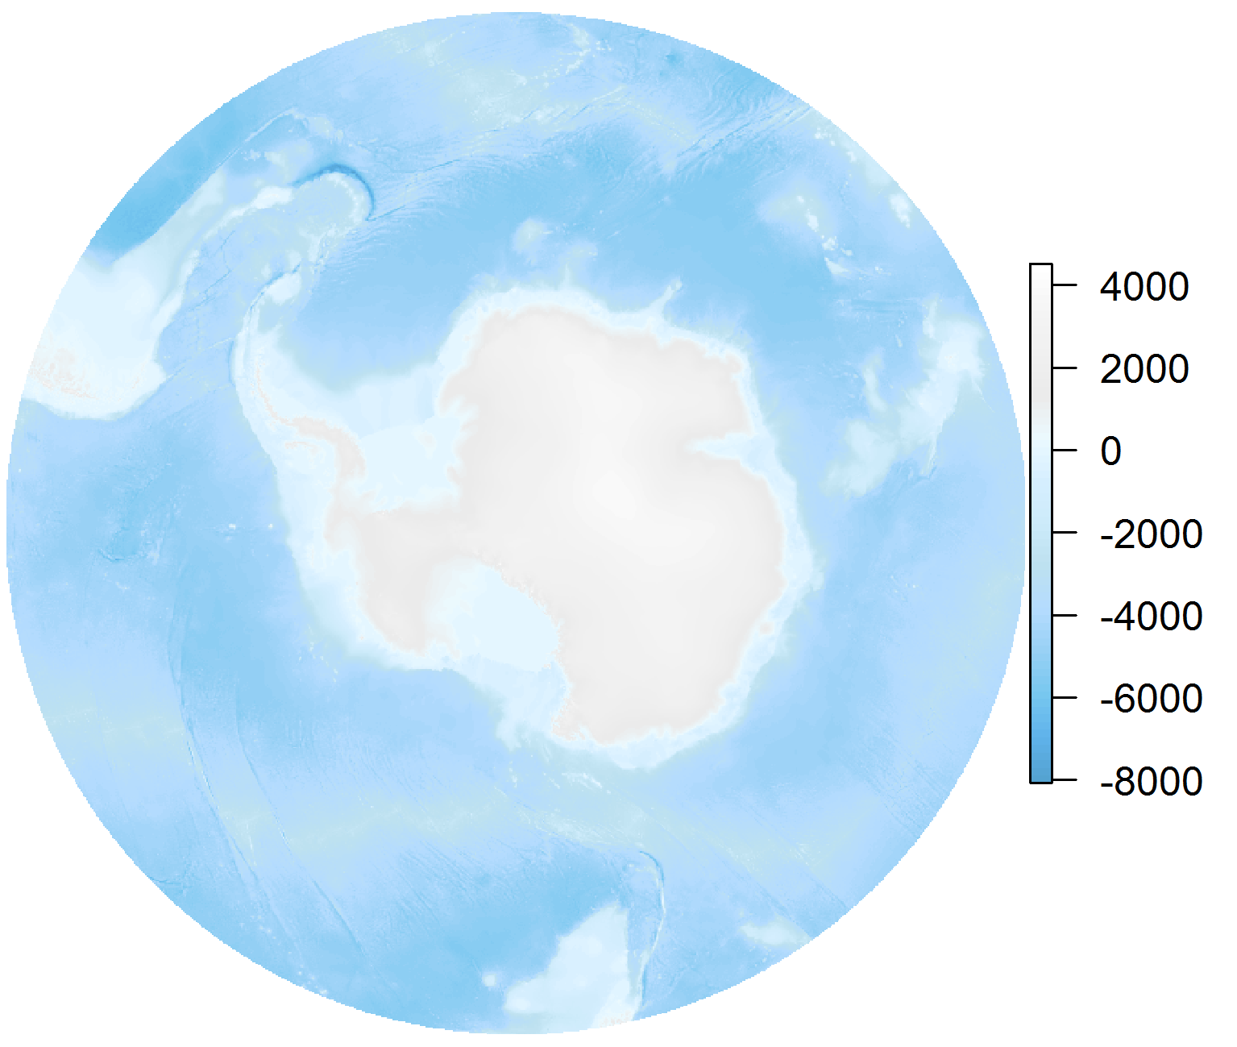
Why can’t I make Circle easily?
🐟
Notes:
So I walked into mikes office complaining “why cant I make circle rasters” he sent me a bunch of code which did the job, the next day he came into my office and said scrap all that I wrote a sweet function. It basically says if it falls outside of the area wanted make it NA, thus giving a sweet circle raster layer.

Slide 5
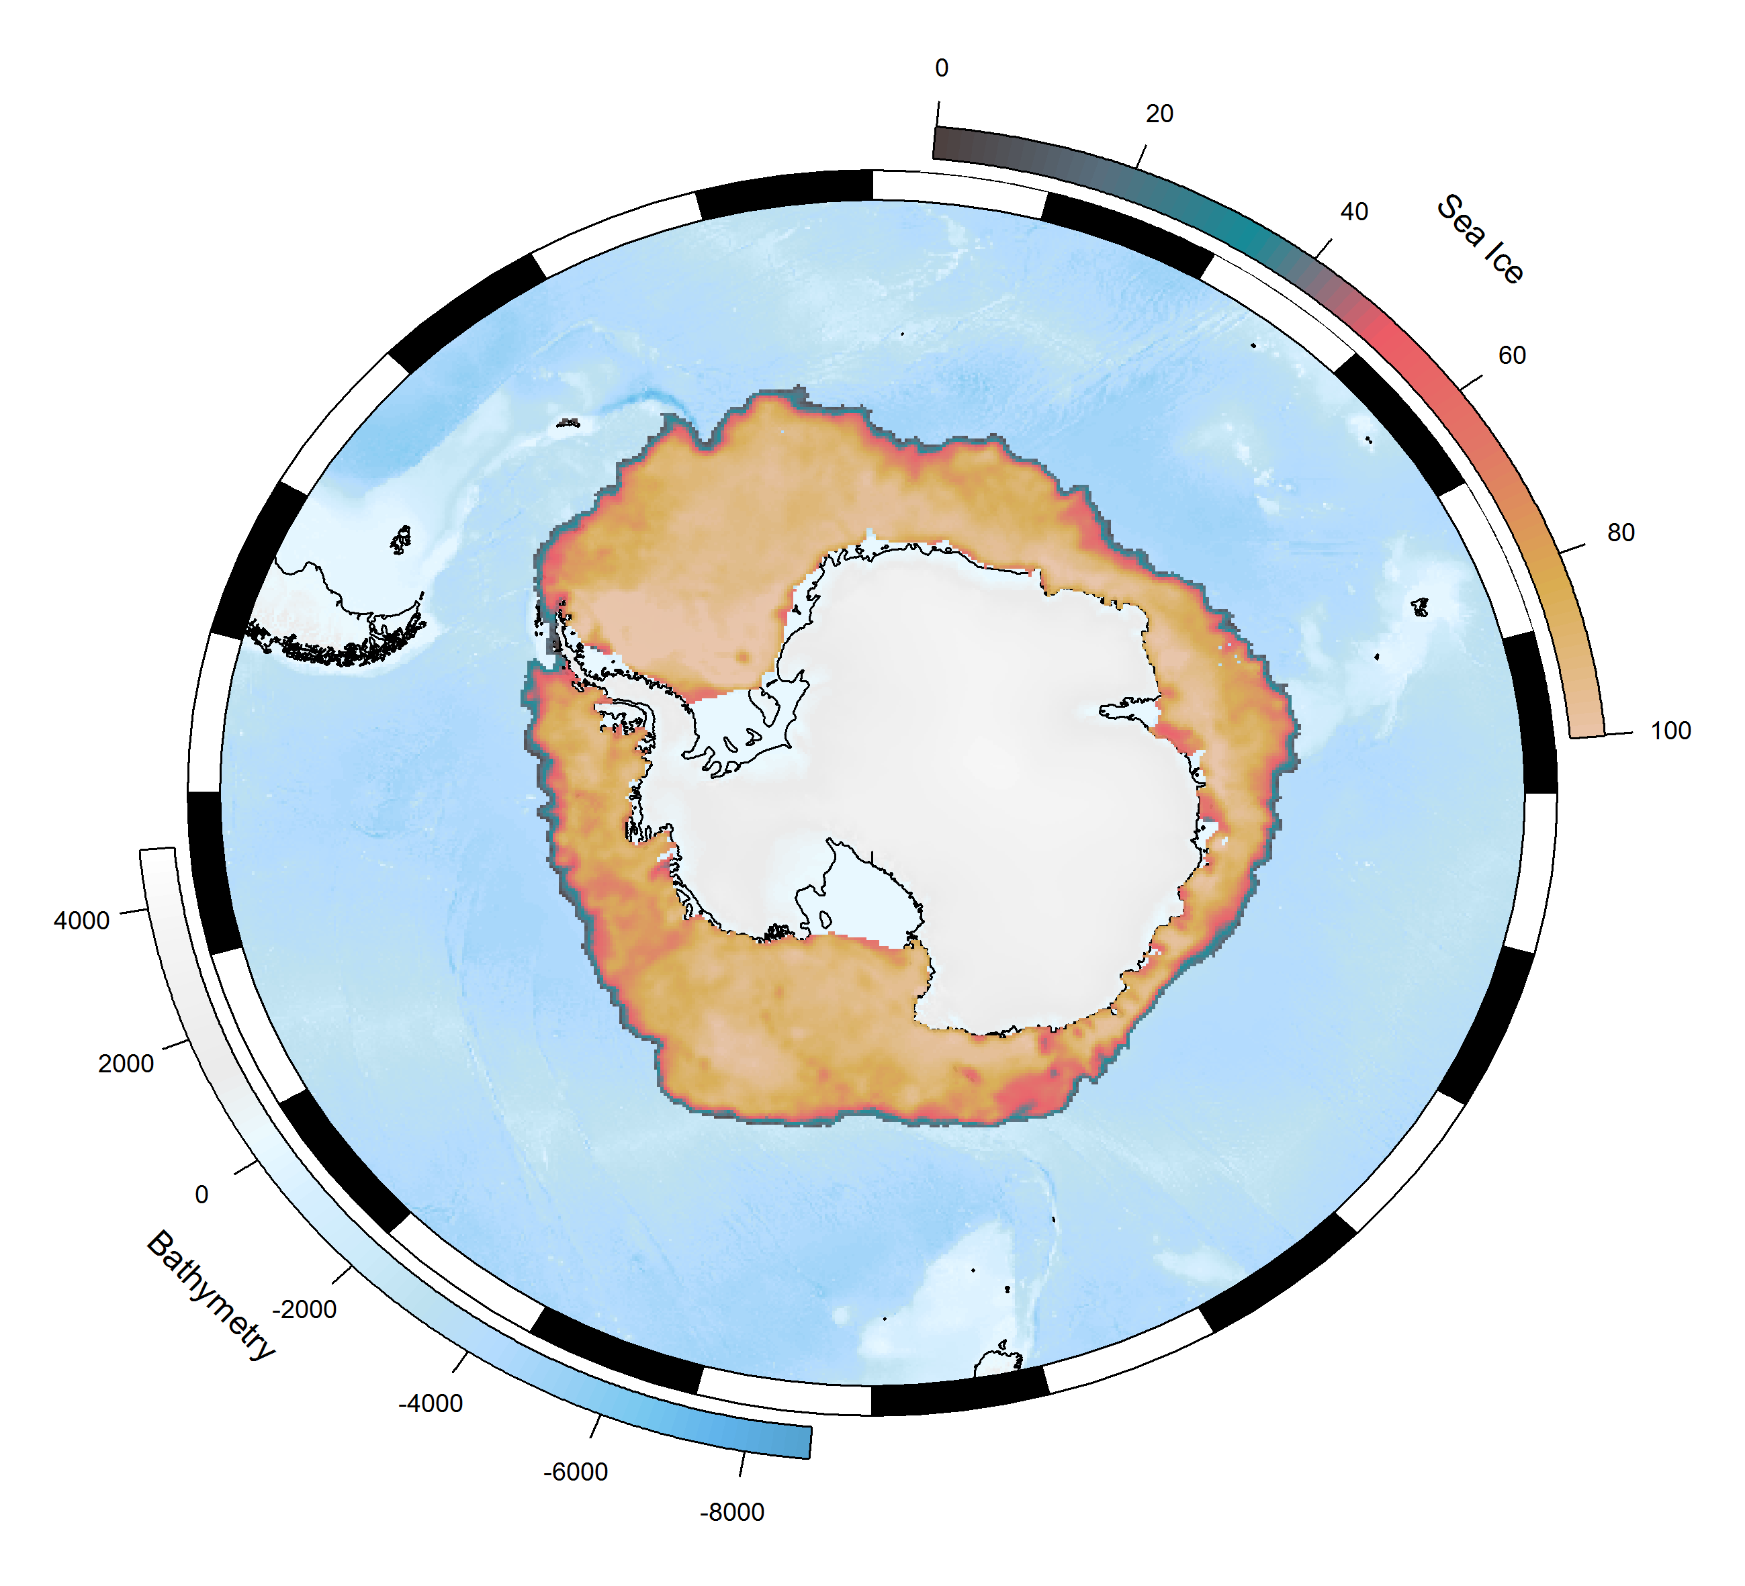
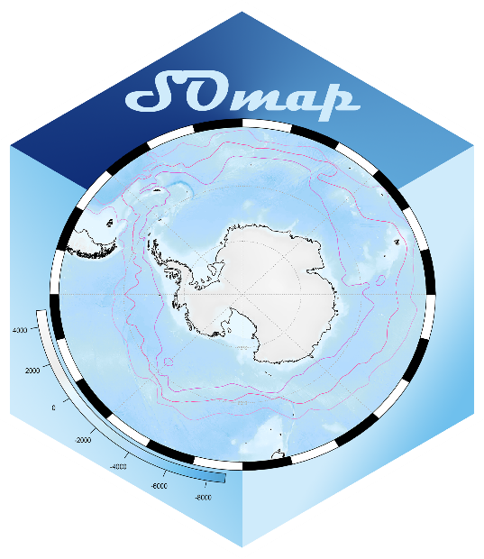
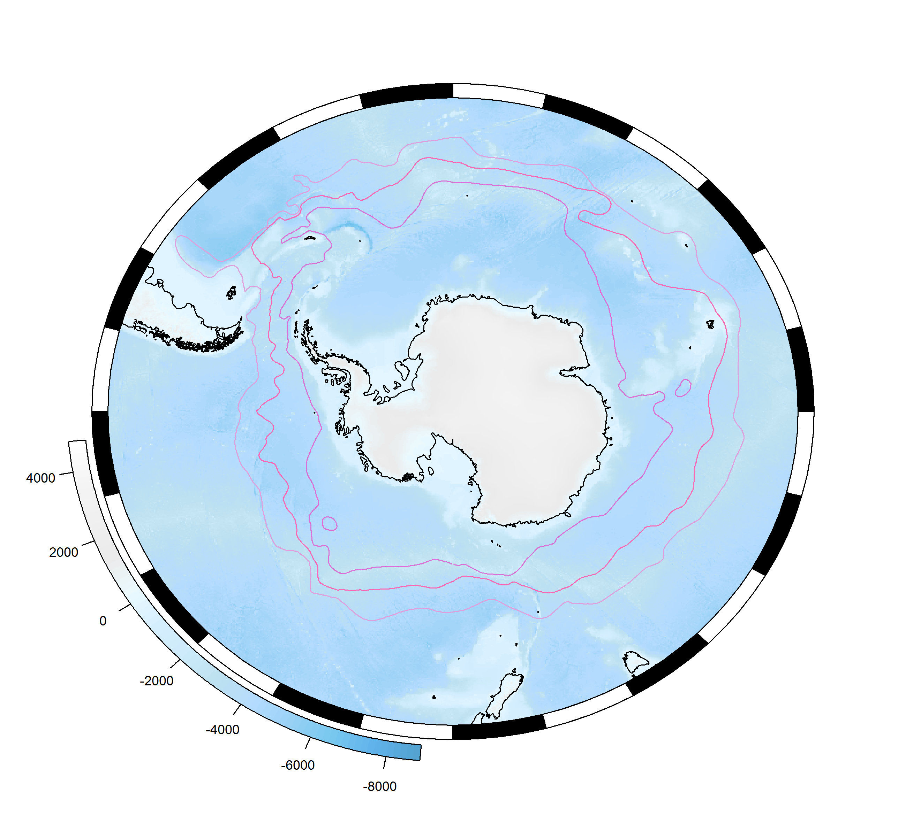
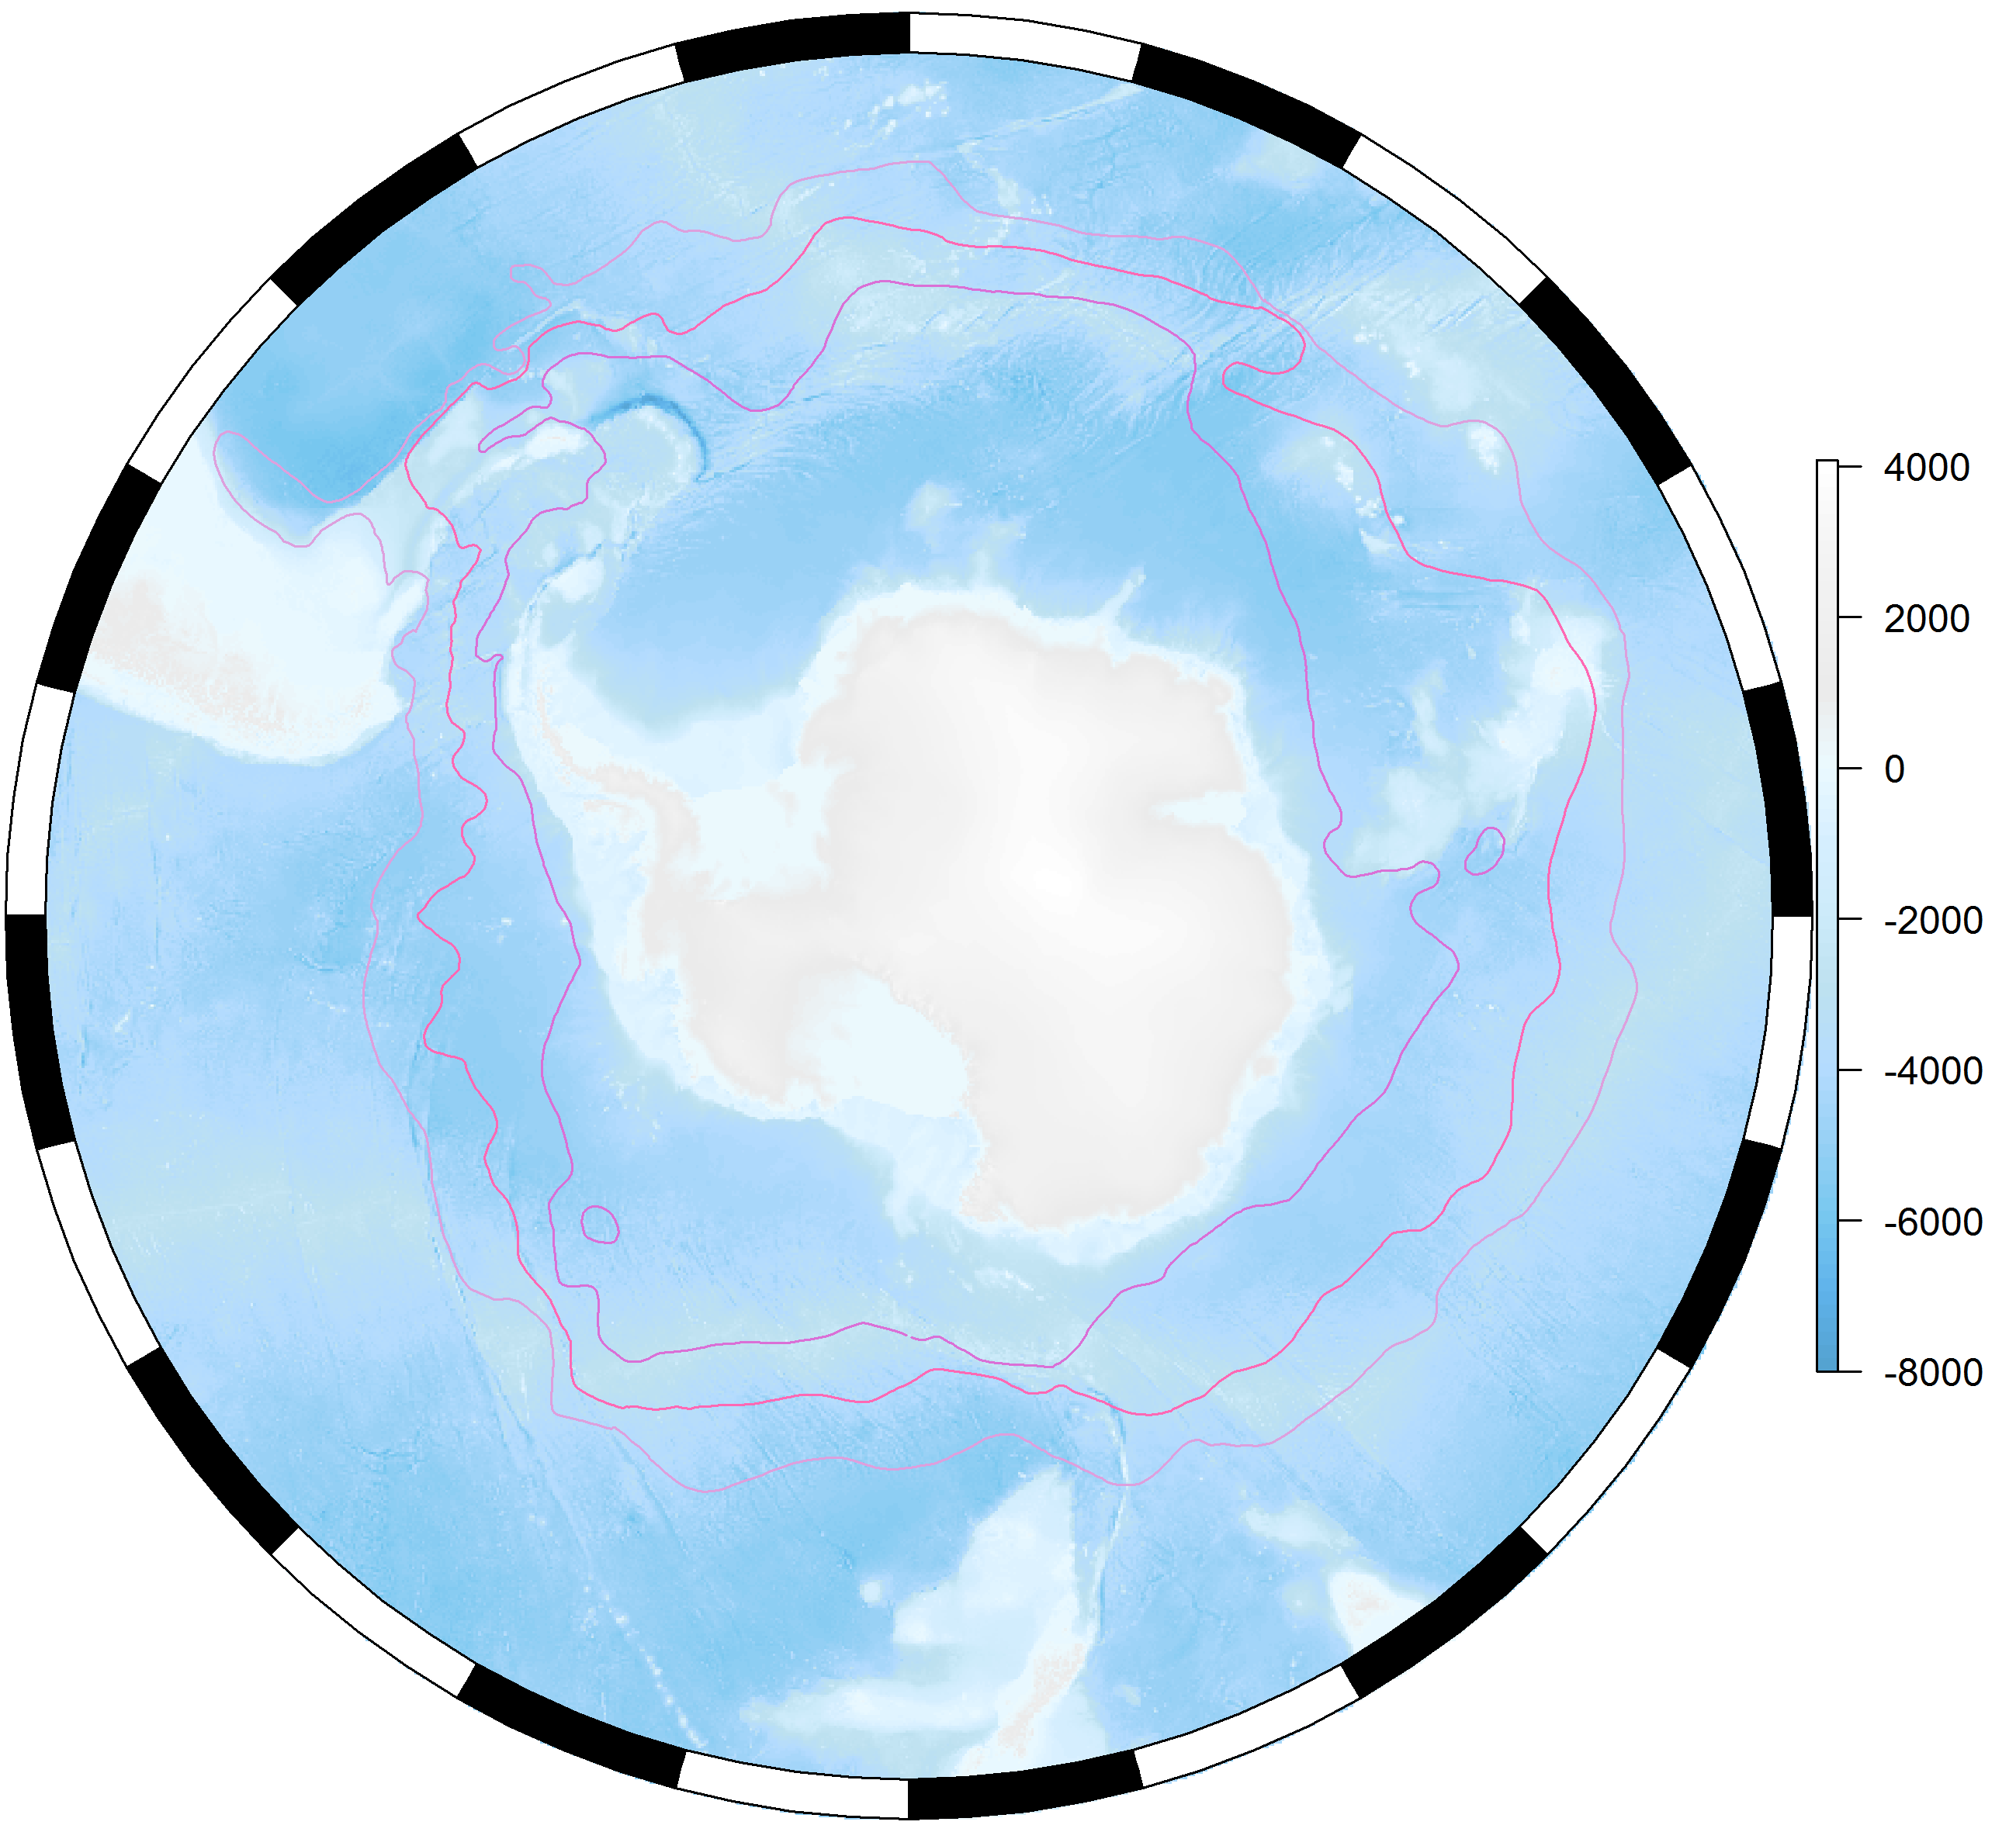
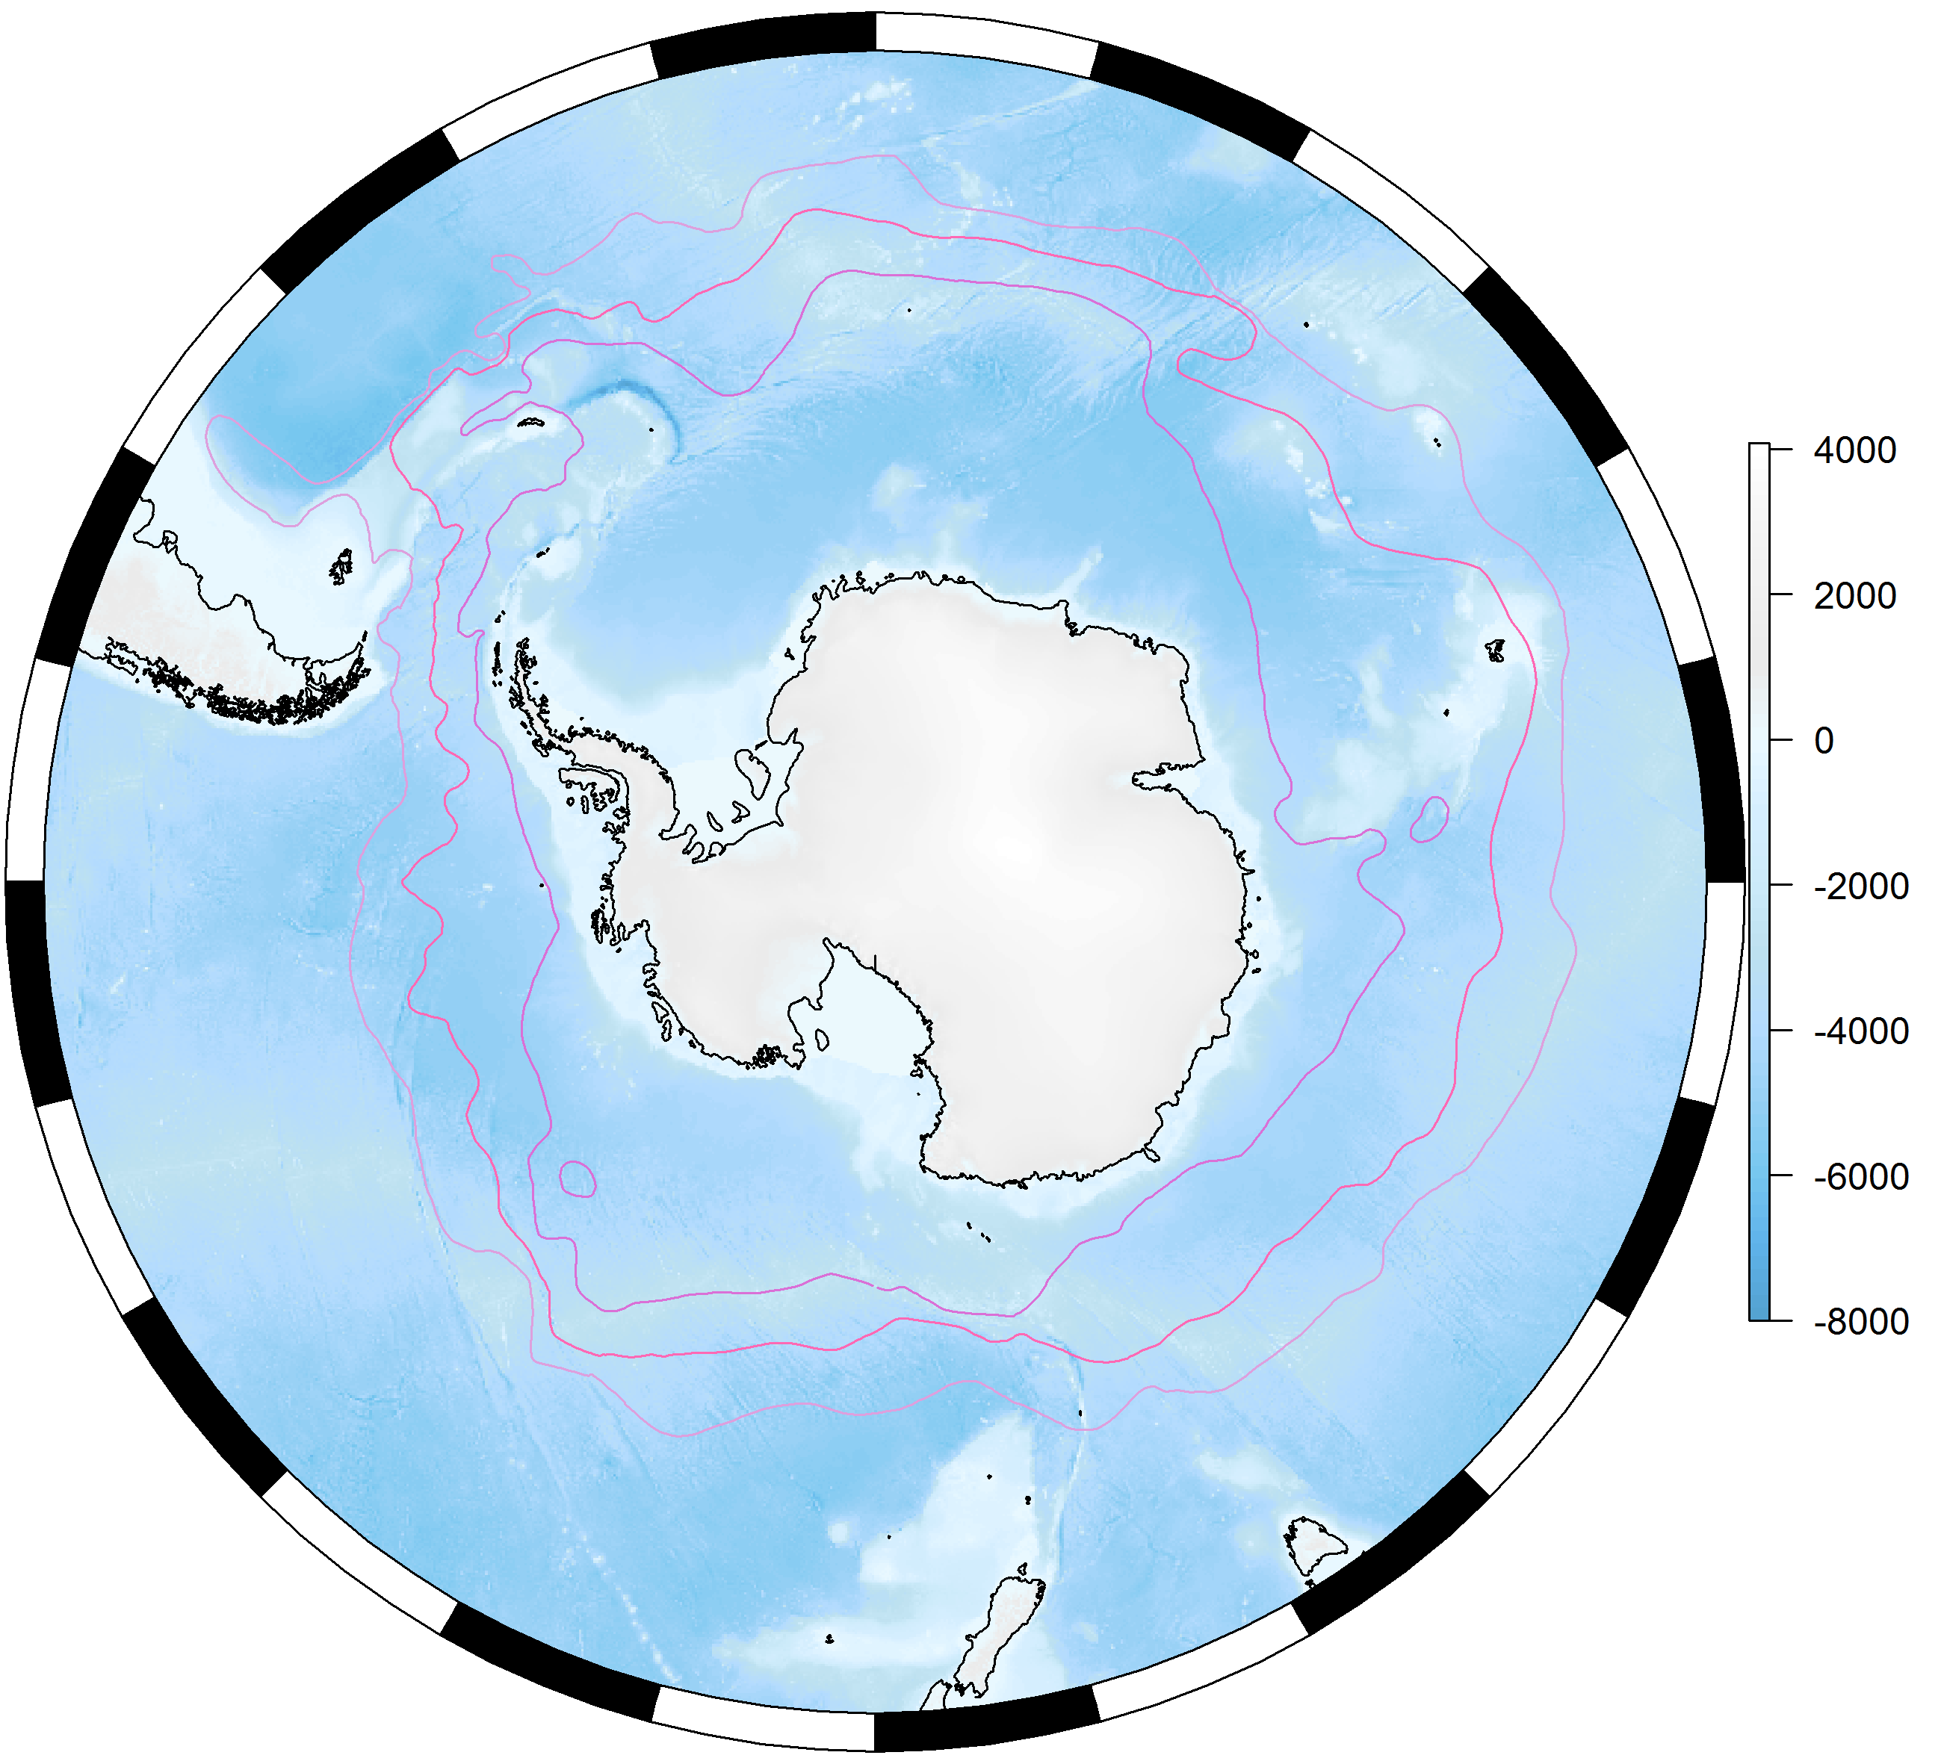
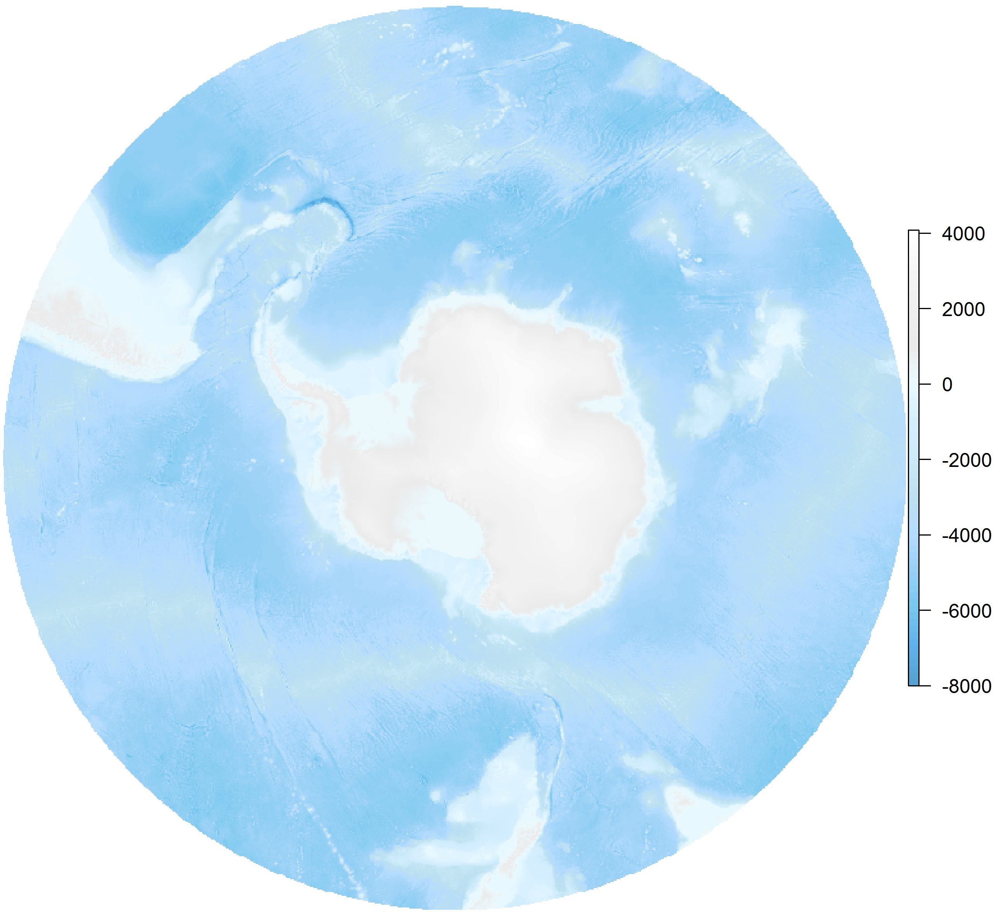
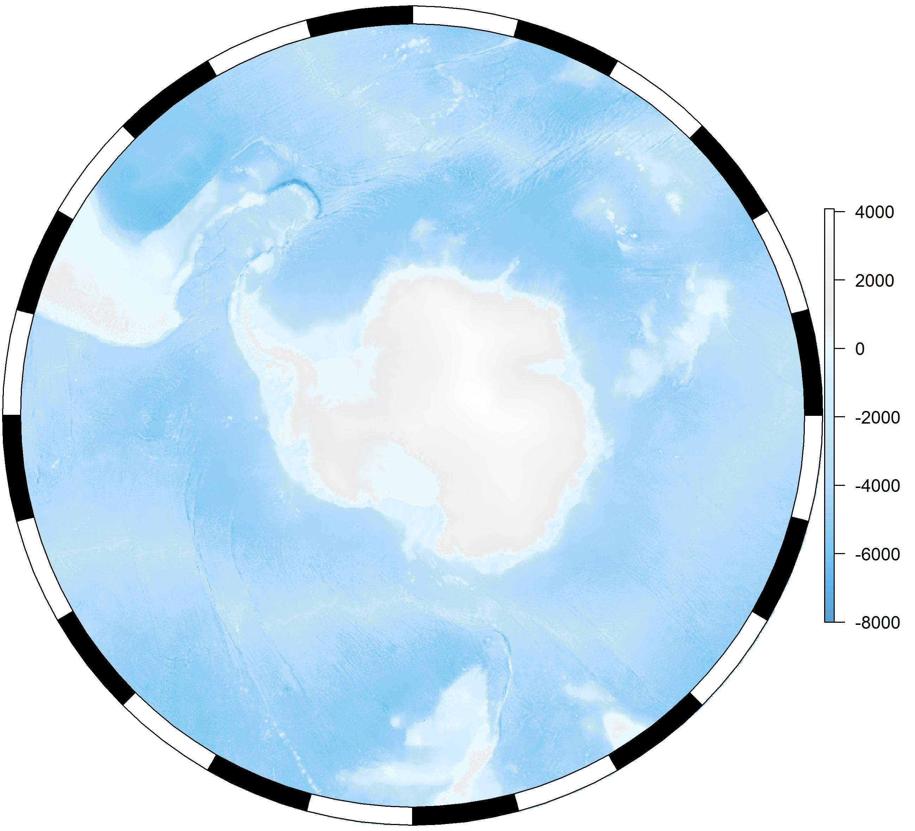

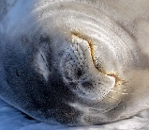
Add the layers
🐟
Notes:
Once we had a round map we started adding layers and then through them all in a package so you could make these maps with one line of code instead of 150. There is also SOmanagement which has all the management boundaries in the Southern ocean. There will be functionality for other round legends, I thought I had finished, turns out I didn’t so I will do it soon.

Slide 6
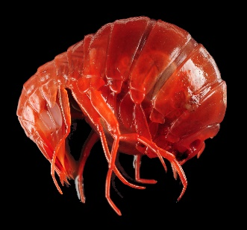
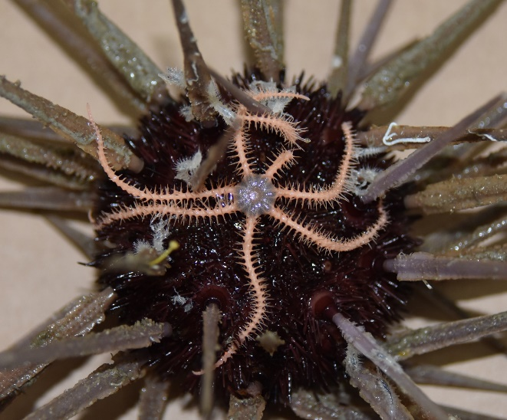
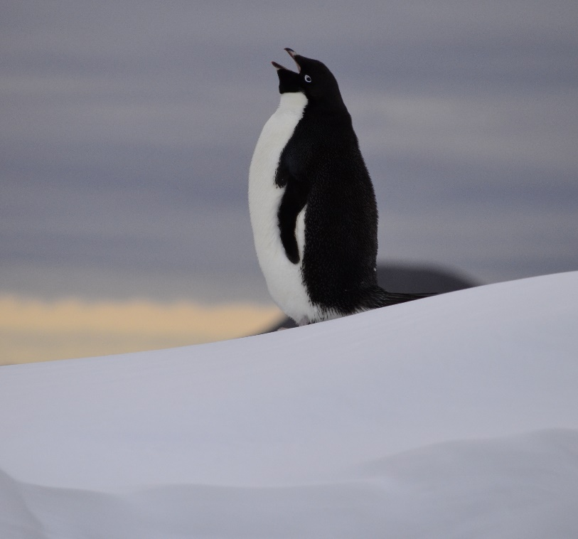
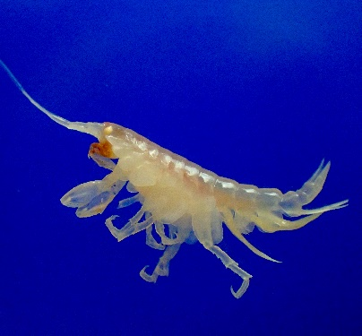
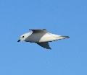
Test on polar projections
A final request;
🐟
Thank you
Notes:
I implore you if you are building functions to put things on maps, please test them on a polar projection.

